Slide 1
Loading…

Slide 2



Project “iStopWatch”
Team №1 - group 46

Slide 3
Table of content
What is “iStopWatch”
How to use it – commands
How it works
How it looks like
Why this project is better than the others
Photos
Live demo

Slide 4
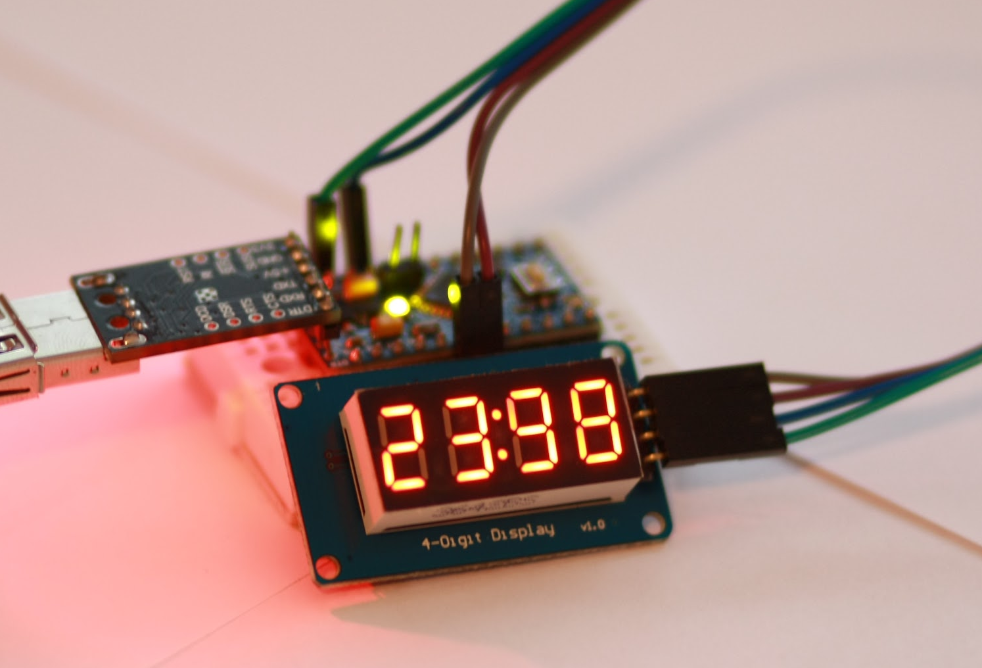
What is “iStopWatch” ?
“iStopWatch” is simple stopwatch controlled by serial monitor of Arduino.

Slide 5
How to use it - commands
Command “s” - start stopwatch
Command “p” - pause stopwatch
Command “r” - reset stopwatch

Slide 6
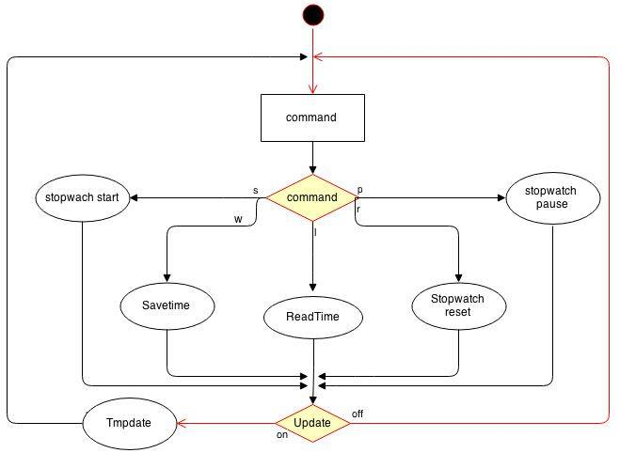
How it works

Slide 7
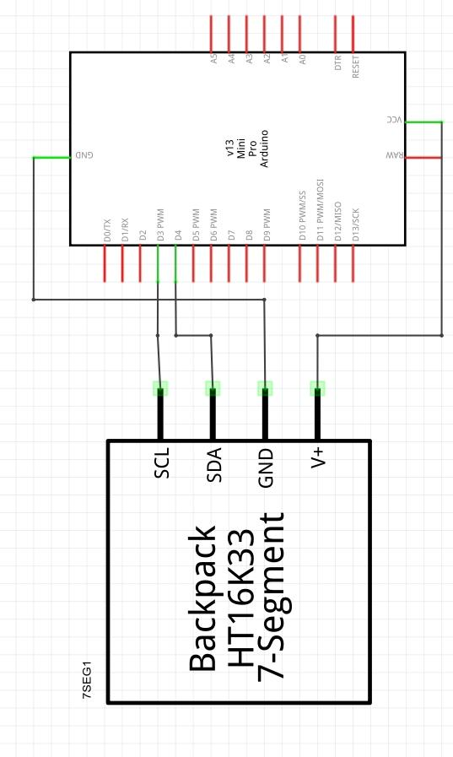
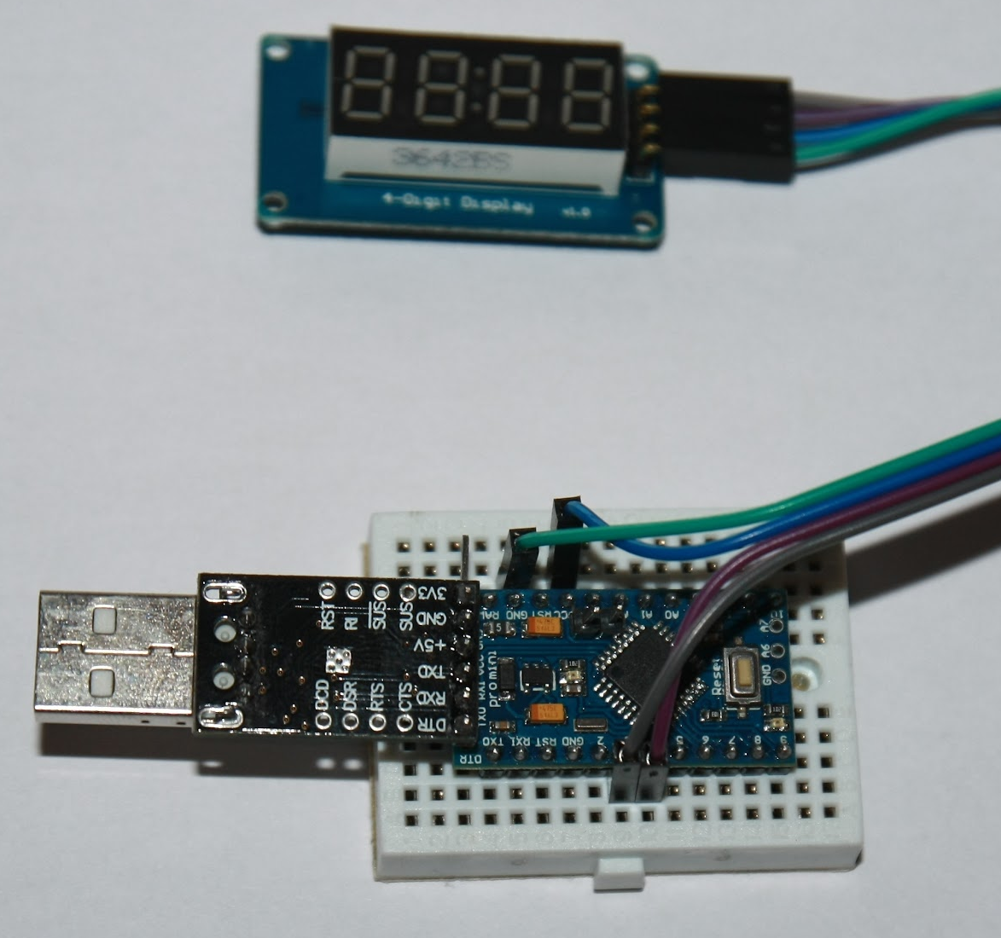
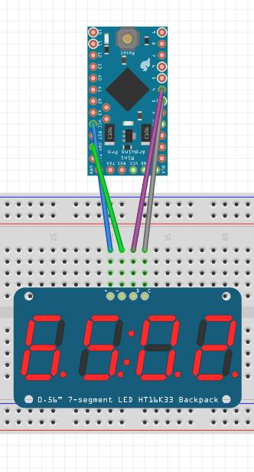
How it looks like

Slide 8
Why this project is better than the others
We have two external commands
Command “w” - save time
Command “l” - list saved times
And second arduino project

Slide 9
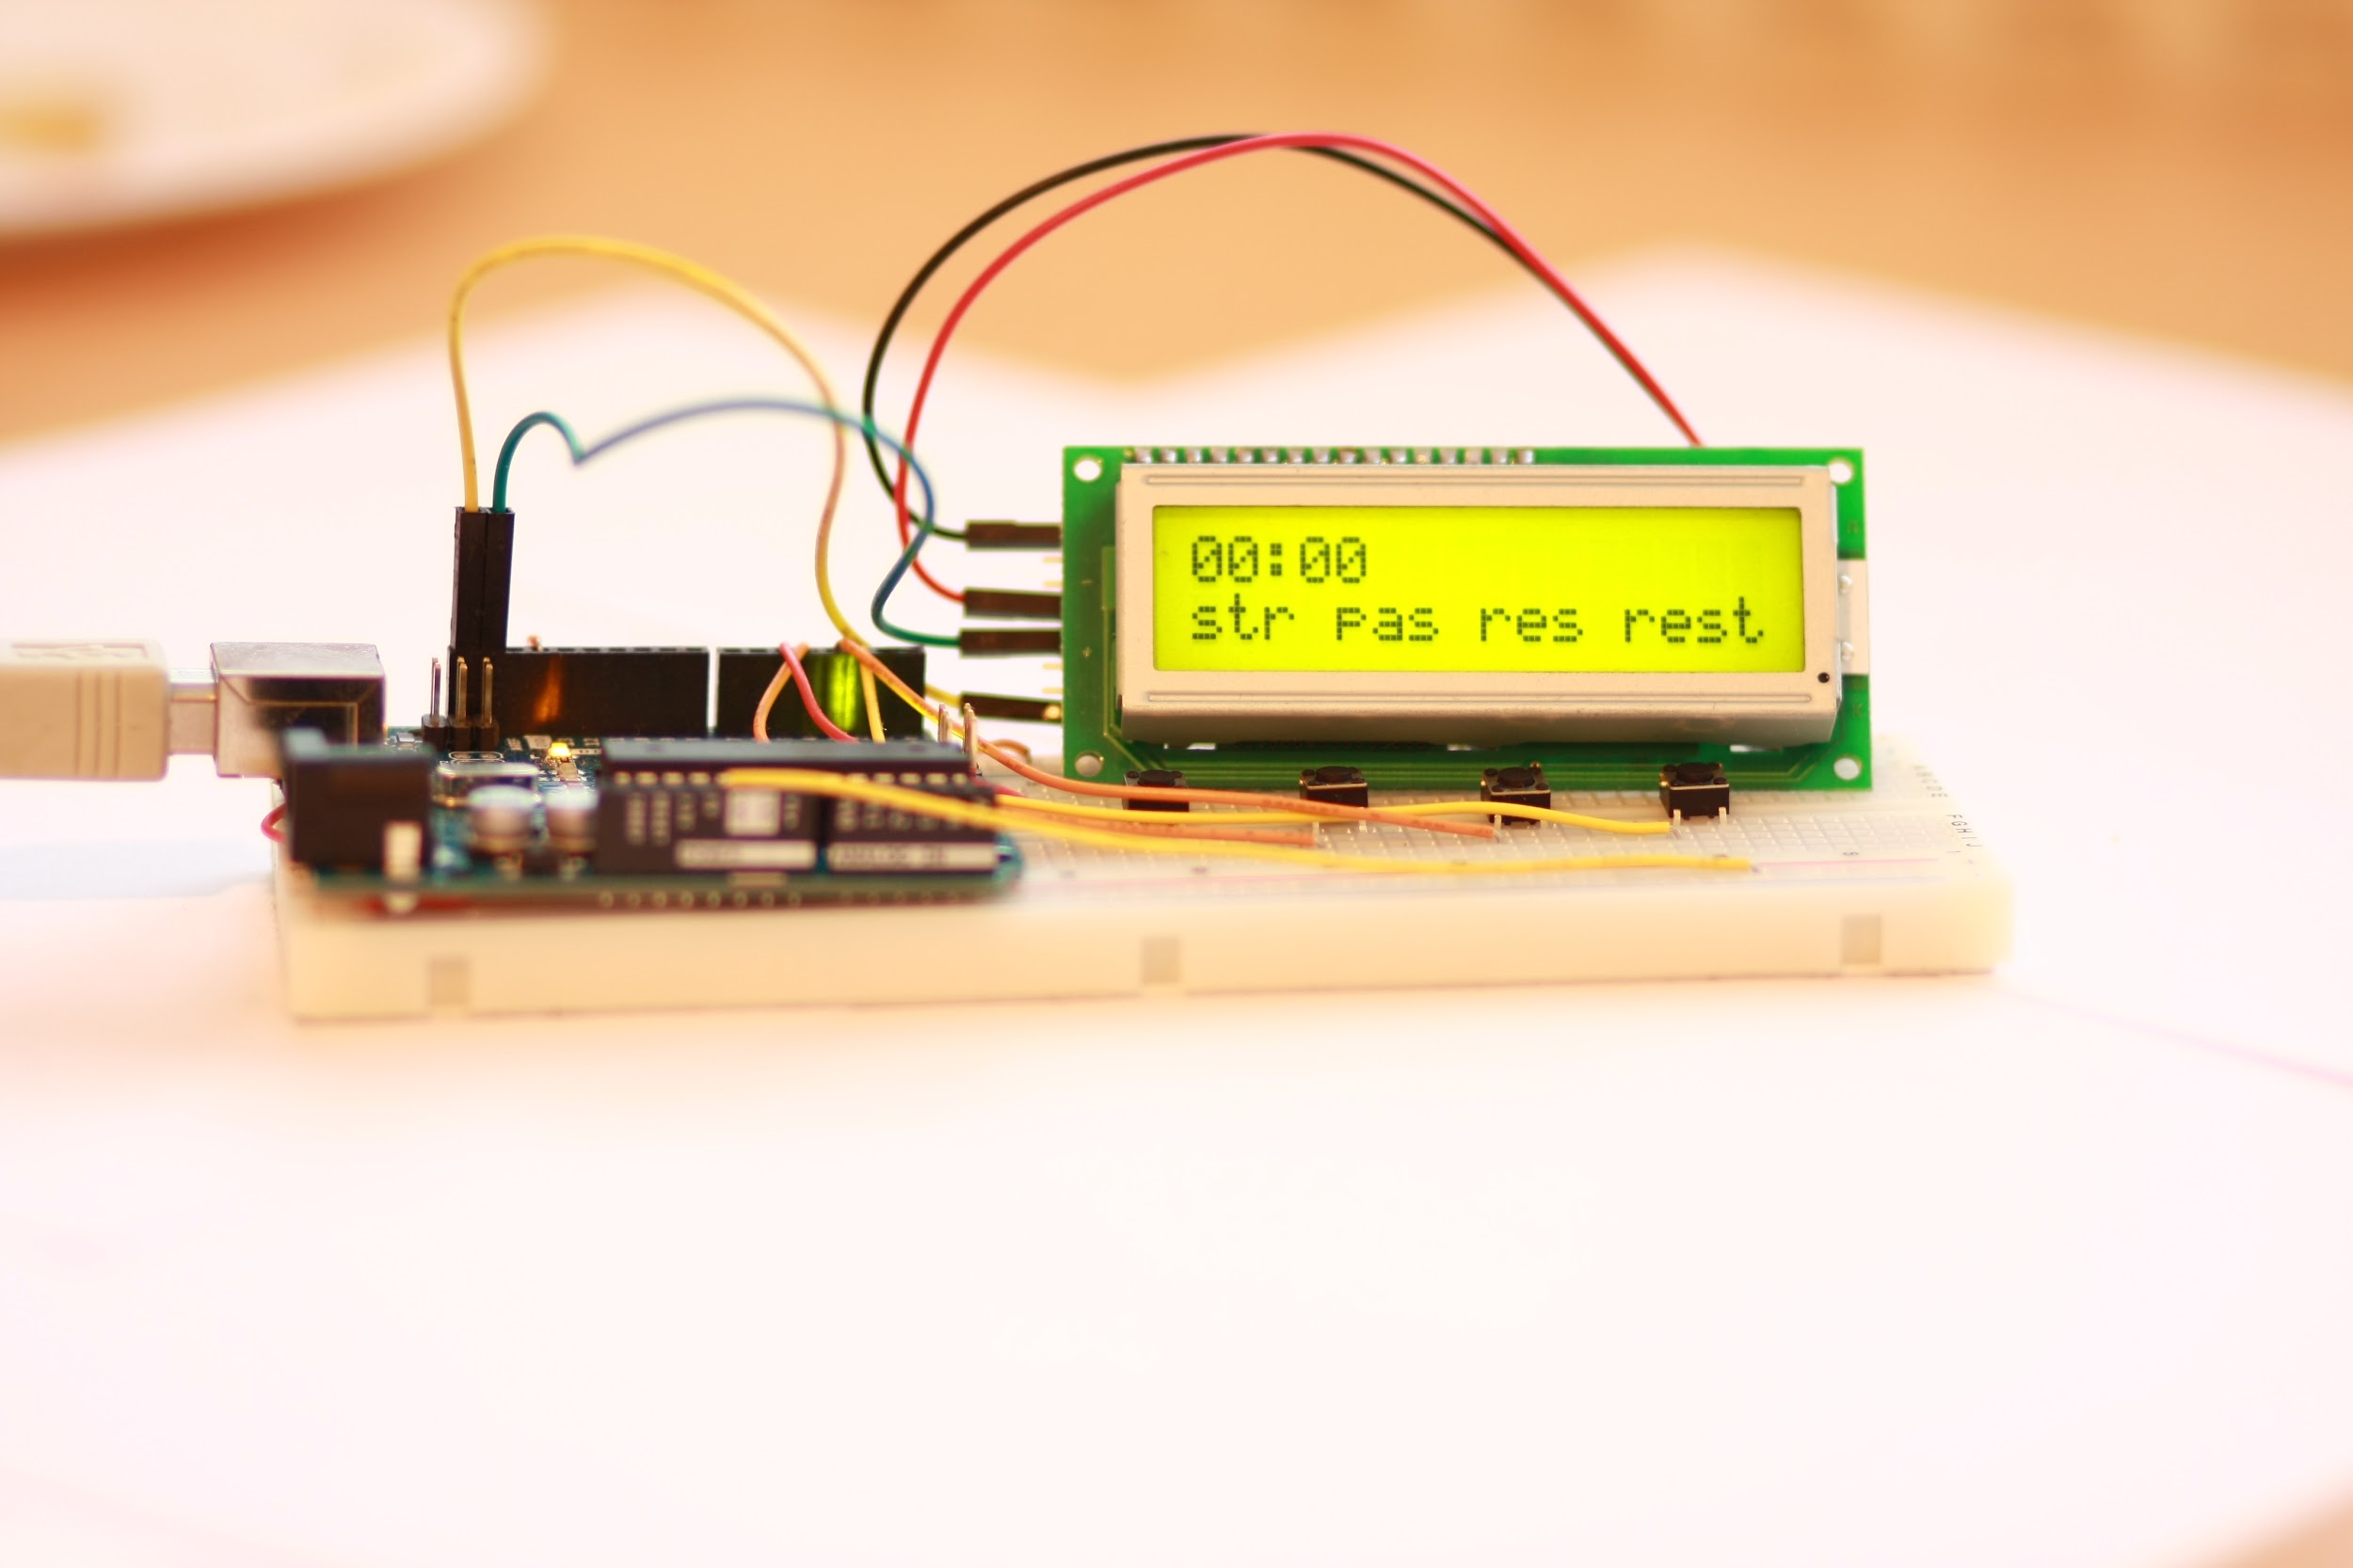
Second arduino project

Slide 10
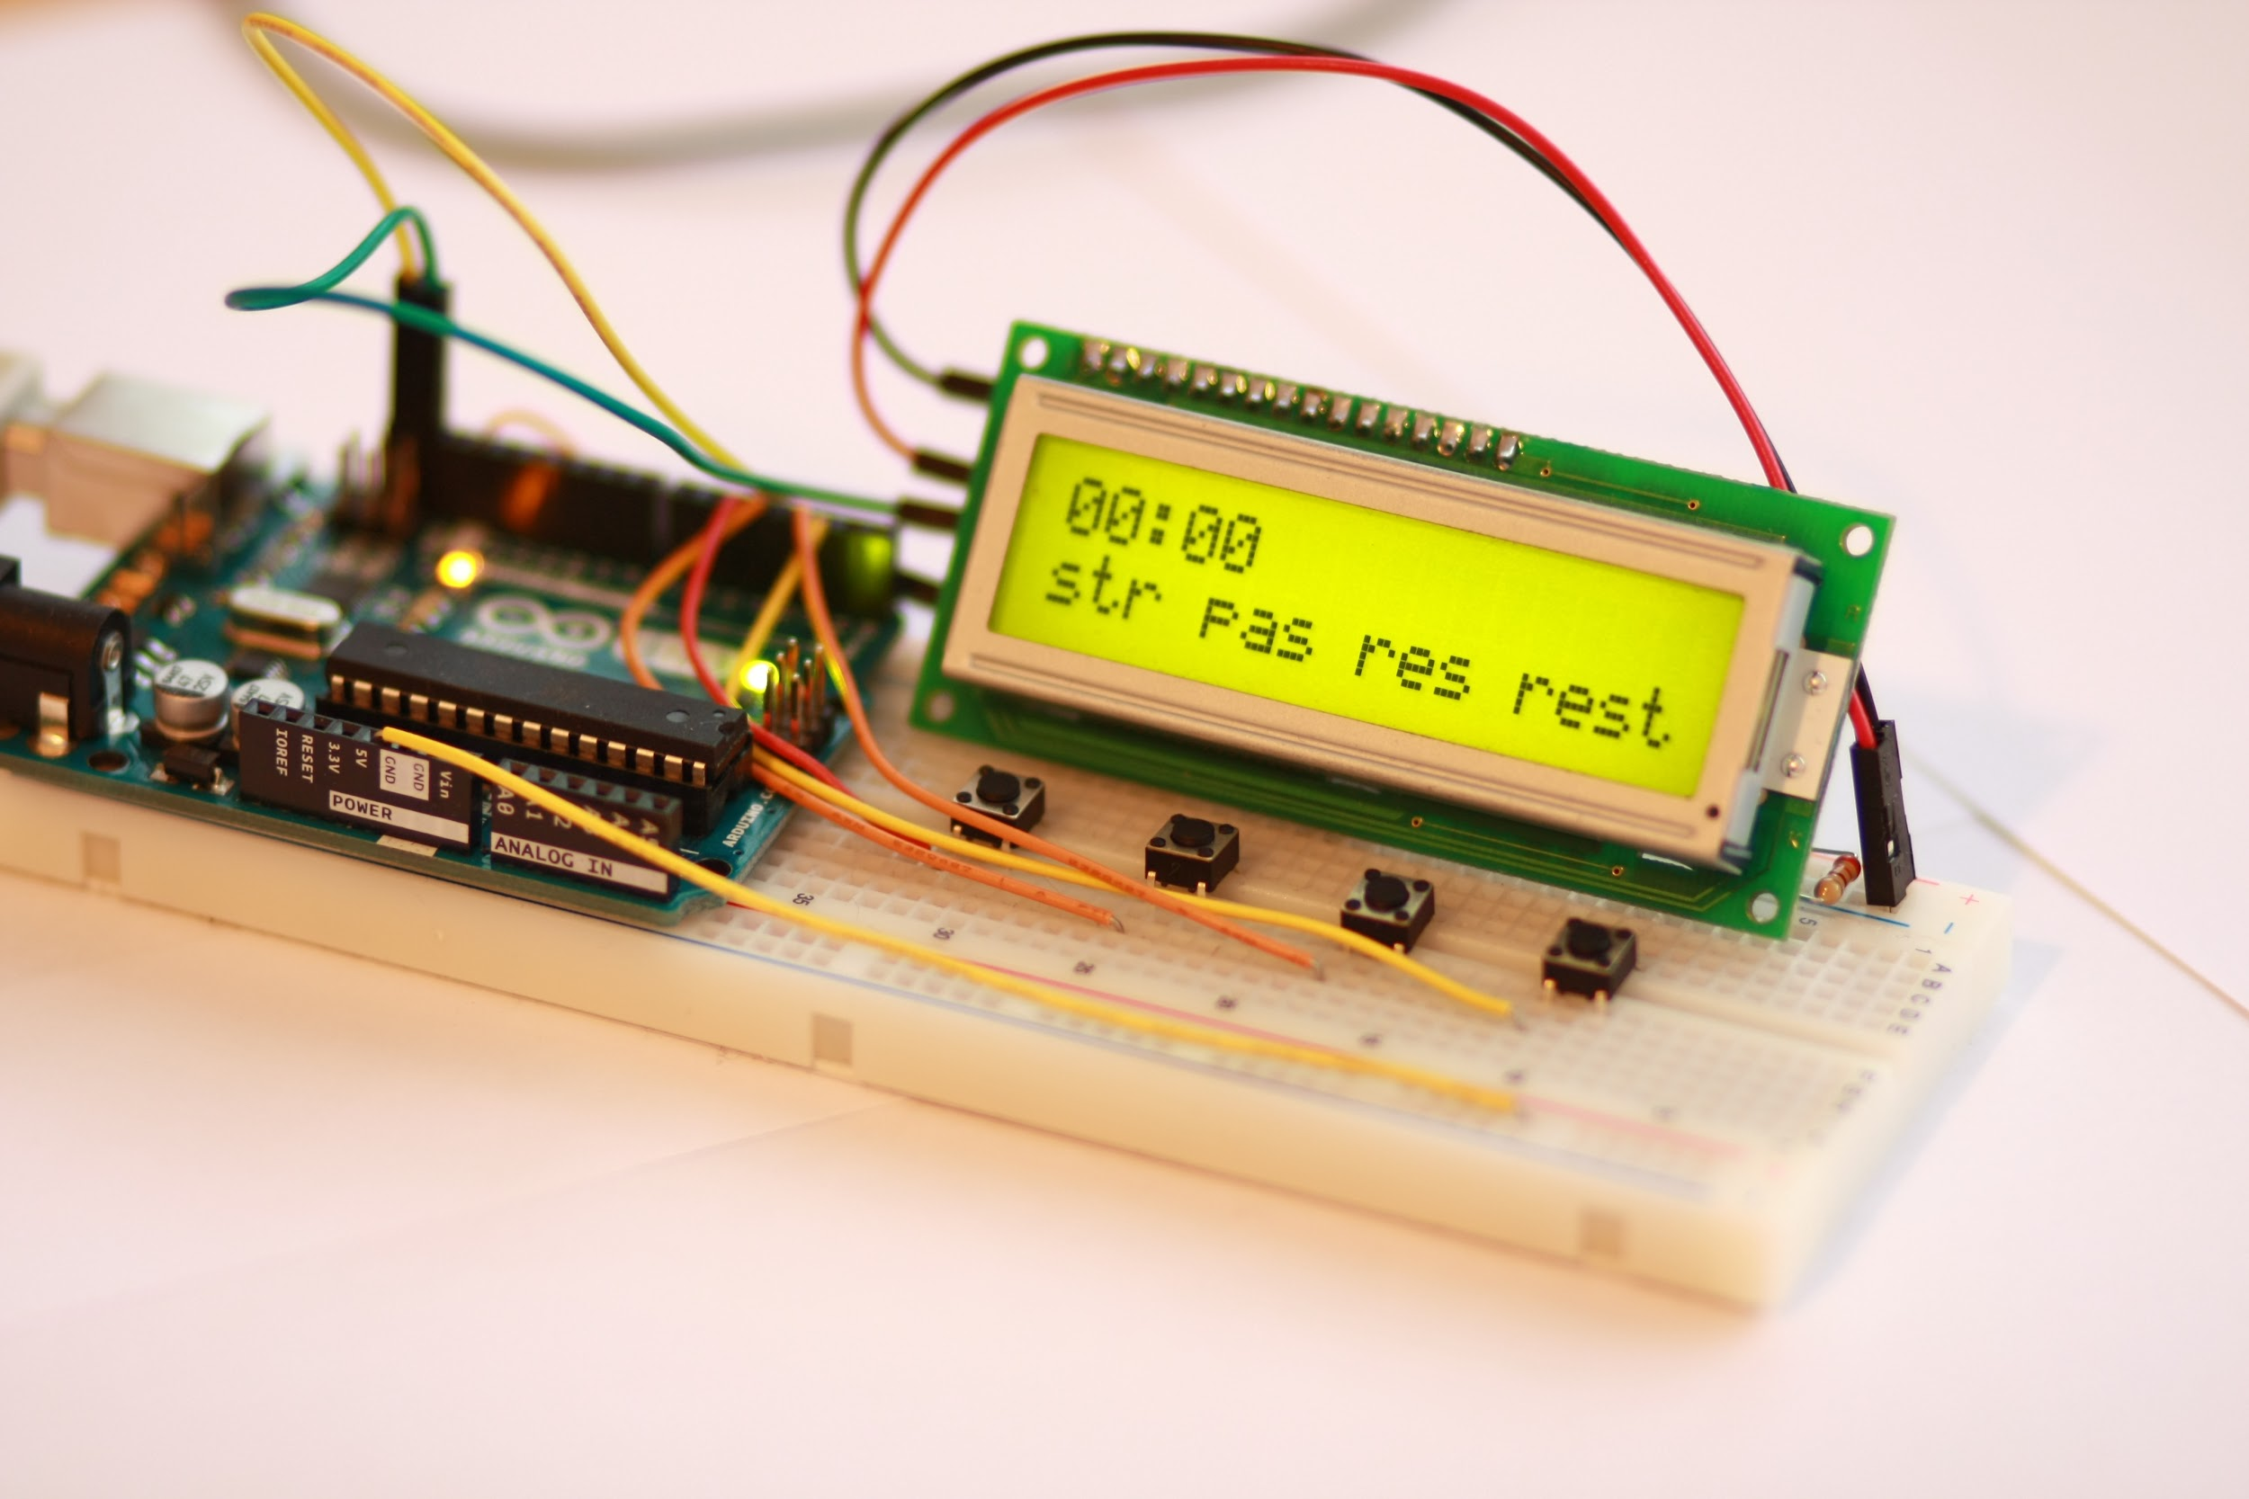
Photos

Slide 11
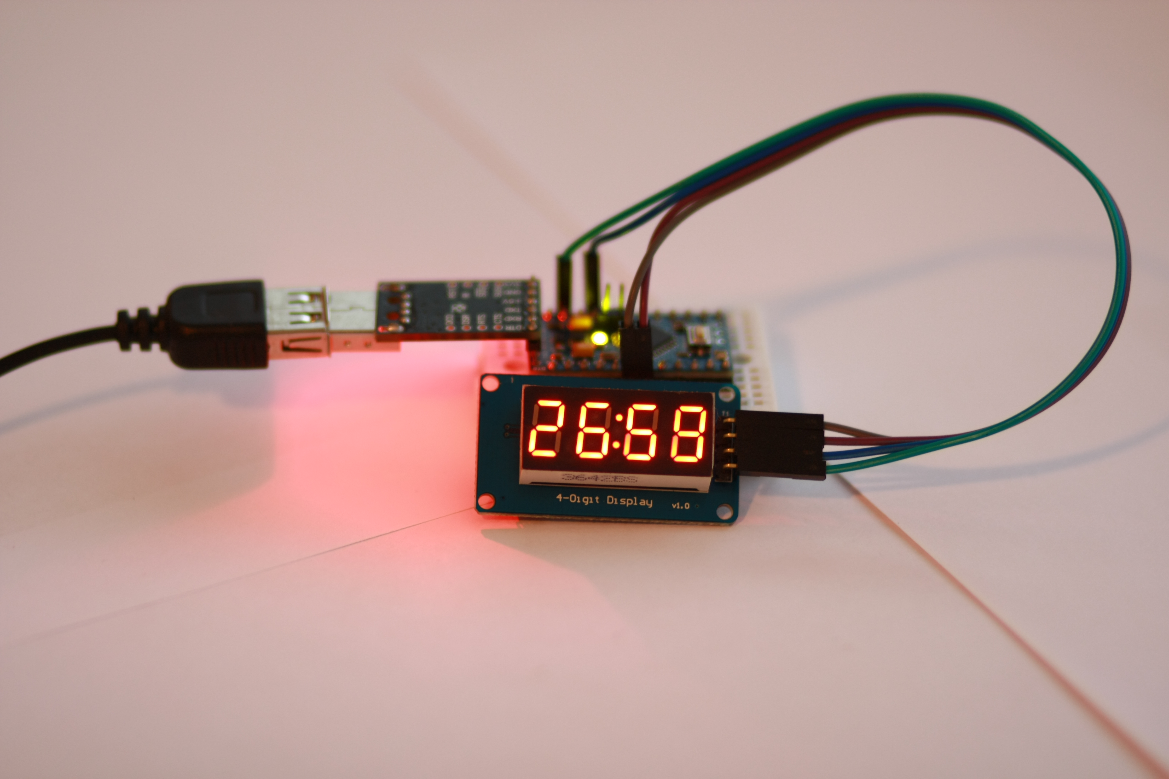
Photos

Slide 12
Live Demo

Slide 13


